Slide 1

Securing Employment Opportunities: Machine Learning Solutions for Fake Job Detection
ADITYA ENGINEERING COLLEGE(A)
Batch No : 05
Under the Guidance of
Mrs. T. Sudha Rani M. Tech.,(Ph.D.)
Associate Professor
Department of CSE
Aditya Engineering College (A)
Presented By
Tippani Kavya Sri (20A91A0560)
Velechety Naga Sai Srinitha (20A91A0562)
Bhumika Sree Sarella (20A91A0508)
Namepalli Venkata Ram Vishal Varma (21A95A0501)

Slide 2
Contents
1.Abstract
2.Introduction
2.1 Problem Statement
2.2 Aim & Objective of Project
2.3 Existing system
2.4 Proposed system and Advantages
2.5 Literature Survey Comparison Table
3.Requirement Analysis (SRS/HRS)
4.Architecture
5.Technology/Algorithm Used
6. Conclusion
7. Future Scope
8. References

Slide 3
ABSTRACT
In recent years, due to advancement in modern technology and social communication, advertising new job posts has become very common issue in the present world.
So, fake job posting prediction task is going to be a great concern for all.
Like many other classification tasks, fake job posing prediction leaves a lot of challenges to face.
This is proposed to use different machine learning techniques for classification and predict a job post if it is real or fraudulent.

Slide 4
INTRODUCTION
PROBLEM STATEMENT
Fraudulent job advertisements can be posted against a reputed company for violating their credibility. These fraudulent job post detection draws a good attention for obtaining an automated tool for identifying fake jobs and reporting them to people for avoiding application for such jobs.
For this purpose, machine learning approach is applied which employs several algorithms for recognizing fake posts.
These models leverage advanced algorithms to analyze patterns, detect anomalies, and identify characteristics associated with fraudulent job postings.
By mitigating the impact of fraudulent activities in the recruitment process, we aim to create an environment where job seekers can explore opportunities with confidence, knowing that the jobs they apply for are genuine and trustworthy.

Slide 5
AIM & OBJECTIVE
Aim:
The main aim of the project is to develop a fake job prediction using machine learning models by using Employment Scam Aegean Dataset (EMSCAD) containing 18000 samples.
Objective:
Collect a dataset containing job id, job description, qualifications, requirements and address.
Develop and train machine learning algorithms to recognize patterns to classify the fake or real jobs posted.
Evaluate the performance of the fake prediction system through cross-validation and real-world testing, assessing accuracy, precision and other relevant relatives.

Slide 6
LITERATURE SURVEY
S.No | Reference Paper Title | Purpose | Drawbacks
1 | S. Vidros, C. Kolias, G. Kambourakis and L. Akoglu, "Automatic Detection of Online Recruitment Frauds: Characteristics Methods and a Public Dataset" | For fake job prediction | The paper acknowledges that the dataset used for experimentation is small and curated.
2 | B. Alghamdi and F. Alharby, "An Intelligent Model for Online Recruitment Fraud Detection", Journal of Information Security, vol. 10, | For fake job prediction | The paper acknowledges that the dataset used for experimentation is small and curated.
3 | T. Van Huynh, V. D. Nguyen, K. Van Nguyen, N. L.-T. Nguyen, and A.G.-T. Nguyen, “Hate Speech Detection on Vietnamese Social Media Text using the Bi-GRU-LSTM-CNN Model | For fake job prediction | The paper acknowledges that the dataset used for experimentation is small and curated.

Slide 7
EXISTING SYSTEMS:
In the existing model, to detect fraud exposure in an online recruitment system. They experimented on EMSCAD dataset using data mining algorithm.
They worked on this dataset in three steps- data pre-processing, feature selection and fraud detection using classifier.
In the preprocessing step, they removed noise and html tags from the data so that the general text pattern remained preserved. They applied feature selection technique to reduce the number of attributes effectively and efficiently.
DISADVANTAGES:
Low accuracy
More time taking process
High cost

Slide 8
PROPOSED SYSTEM:
In the proposed system, we identified job scammers as fake online job advertiser.
They found statistics about many real and renowned companies and enterprises who produced fake job advertisements or vacancy posts with ill-motive.
we experimented on EMSCAD dataset using several classification algorithms like naive bayes classifier, random forest classifier, etc.
Random Forest Classifier showed the best performance on the dataset with 94.5% classification accuracy.
we found navy bayes performing very poor on the dataset. Logistic regression classifier performed well when they balanced the dataset and experimented on that.

Slide 9
ADVANTAGES:
High accuracy
Less time taking process
Less cost

Slide 10
System Requirements
HARDWARE REQUIREMENTS :
System; i3 processor
Hard Disk: 500GB
Input Devices: keyboard, mouse
RAM: 4GB
SOFTWARE REQUIREMENTS:
Operating system: Windows 10
Coding Language; Python
Front-end: Python
Back-end: Django-ORM
Designing: HTML, CSS and JavaScript
Data Base: MYSQL(WAMP Server)

Slide 11
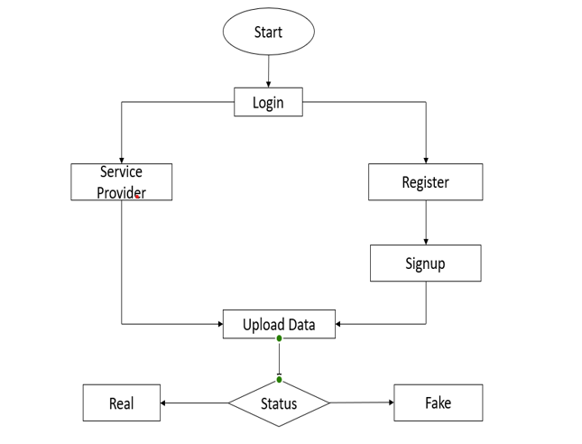
Project Flow /Architecture

Slide 12
Technology/Algorithm Used
K-Nearest Neighbors (KNN)
Naïve Bayes
Random Forest
SVM

Slide 13
Future Scope
Model selection: extract relevant features from the text data and choose a suitable machine learning algorithm for classification.
Model training and evaluation: Train the selected model on the dataset, evaluate its performance using metrics and fine-tune if necessary.
Deployment and maintenance: Deploy the trained model for use and regularity monitoe and update it to ensure ongoing effectiveness.

Slide 14
Table for Student Contribution
S. no | TASKS | 20A91A0560 | 20A91A0562 | 20A91A0508 | 21A95A0501
1. | Literature Survey | - | Referred Some fake posts regarding jobs and searched news. | Referred fake id’s and posts detection based on projects | -
2. | Problem Formulation | Based on Survey, came with 50% of problem statement | Based on Survey, came with 50% of problem statement | - | -
3. | Requirements Gathering | - | - | Reached out and analyzed requirements | Reached out and analyzed requirements
4. | Resource Estimation | Estimated the required software and resources for project | - | - | Estimated the required software and resources for project
5. | Documentation | Documenting on the full stack modules | - | Documenting the modules | -
6. | PPT Presentation | - | Preparation of the PPT presentations | - | Preparation of the PPT presentations

Slide 15
Modules
Service Provider
In this module, the Service Provider has to login by using valid user name and password. After login successful he can do some operations such as Train and Test Data Sets,View Trained and Tested Accuracy in Bar Chart, View Trained and Tested Accuracy Results,Predict Job Post Type Details,Find Job Post Type Prediction Ratio, Download Trained Data Sets,View Job Post Type Prediction Ratio Results,View All Remote Users.
View and Authorize Users
In this module, the admin can view the list of users who all registered. In this, the admin can view the user’s details such as, user name, email, address and admin authorizes the users.

Slide 16
Modules
Remote User
In this module, there are n numbers of users are present. User should register before doing any operations. Once user registers, their details will be stored to the database. After registration successful, he has to login by using authorized user name and password. Once Login is successful user will do some operations like REGISTER AND LOGIN, POST JOB POST DATA SETS, PREDICT JOB POST PREDICTION, VIEW YOUR PROFILE.

Slide 17
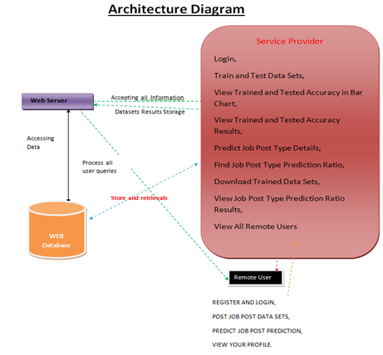

Slide 18
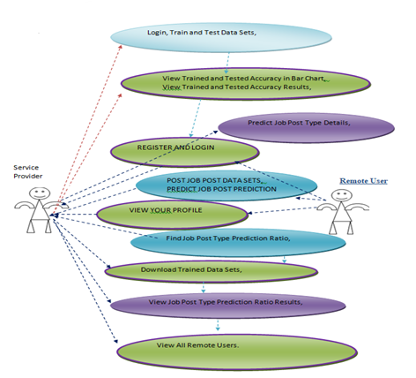
UML DIAGRAMS
1.USE CASE DIAGRAM:
The following shown figure is the Use-case
diagram of our proposed project .It describes
what the system does and how the system
operates internally

Slide 19
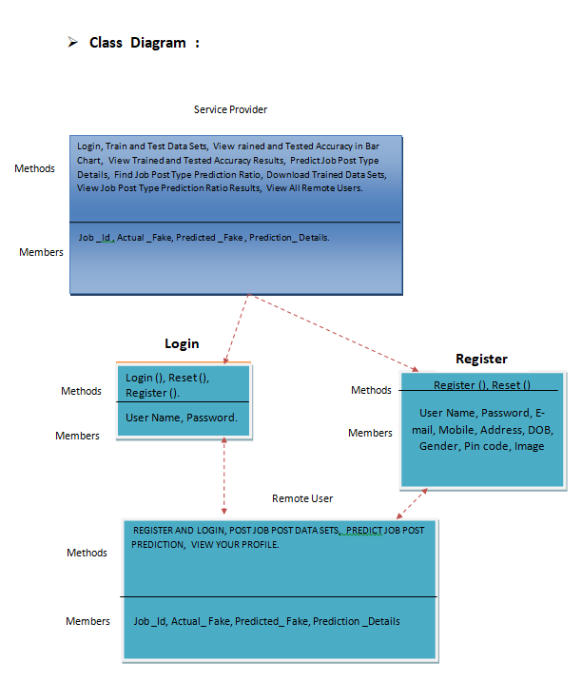
2.CLASS DIAGRAM:
The following shown figure is the Class diagram of our proposed project . It is used to model the objects that make up the system, to display the relationships between the objects and to describe what those objects do and the services that they provide.

Slide 20
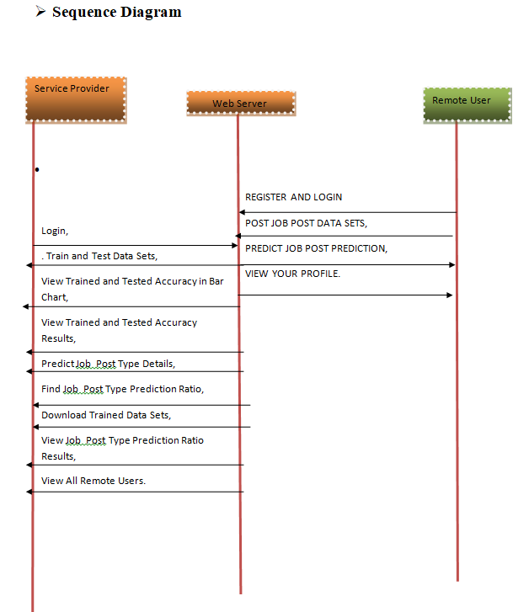
3. SEQUENCE DIAGRAM:
The following diagram is the Sequence diagram This sequence diagram consists of four objects the User, Main, and Audio to Sign.It shows the sequence of actions between the user and the feature Audio to Sign Language Conversion.

Slide 21
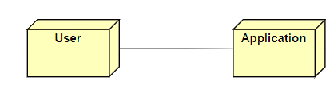
4. DEPLOYMENT DIAGRAM:
A Deployment Diagram shows the hardware of your system and the software in that hardware of the proposed project.The below shown figure is the Deployment diagram of the proposed project.

Slide 22
TESTING
Testing is the process of executing a program to find errors. To make our software perform well, it should be error-free.
Unit Testing
During this first round of testing, the program is submitted to assessments that focus on specific units or components of the software to determine whether each one is fully functional.
2. Integration Testing
Integration testing allows individuals the opportunity to combine all of the units within a program and test them as a group. This testing level is designed to find interface defects between the modules/functions.
Object-Oriented Testing
This testing is a combination of various testing techniques that help to verify and validate object-oriented software.

Slide 23
TESTING
Performance Testing
It is used to test the speed and effectiveness of the program. It is also called load testing. In it we check, what is the performance of the system in the given load.
Verification Testing:
Verification Testing checks to authenticate that the system design and architecture are accurately engineered and free of errors. Verification checks are something like studying the specifications and checking them against the code logic.
Validation Testing:
Validation Testing is an activity that ensures that an end product stakeholders true needs and expectations are met. Its main intent is to check that the final product matches the stakeholder and customer requirements.

Slide 24
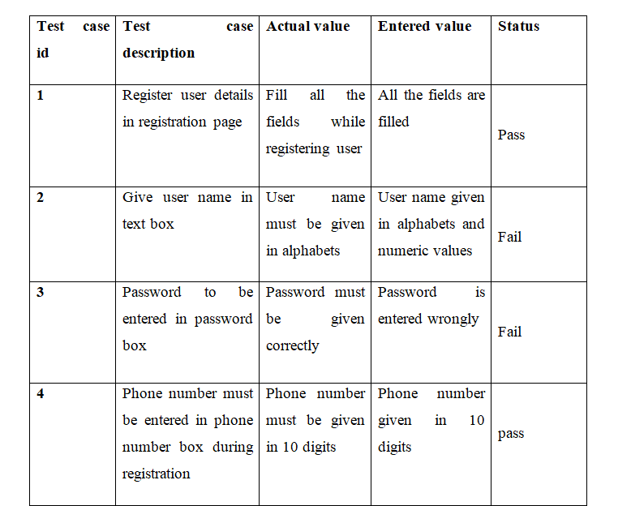
TESTCASES

Slide 25
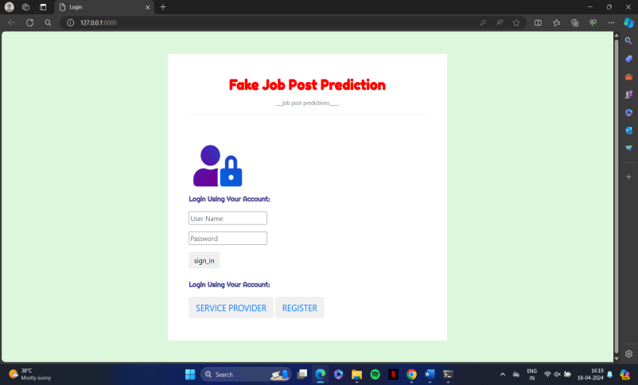
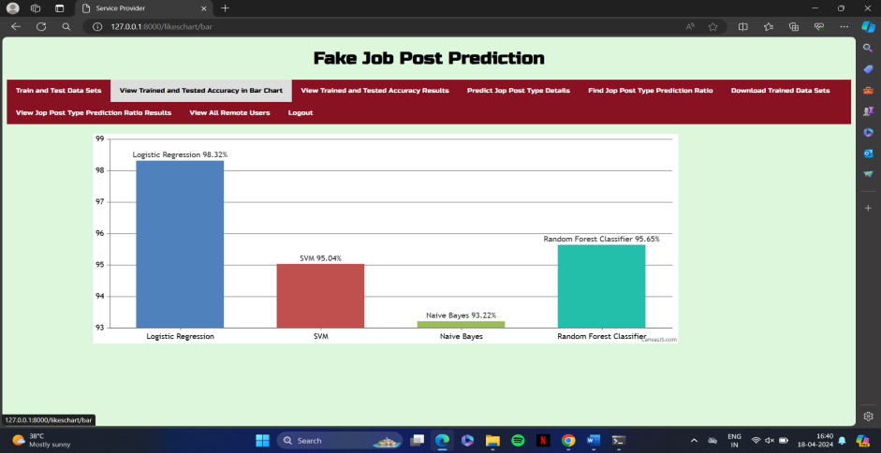
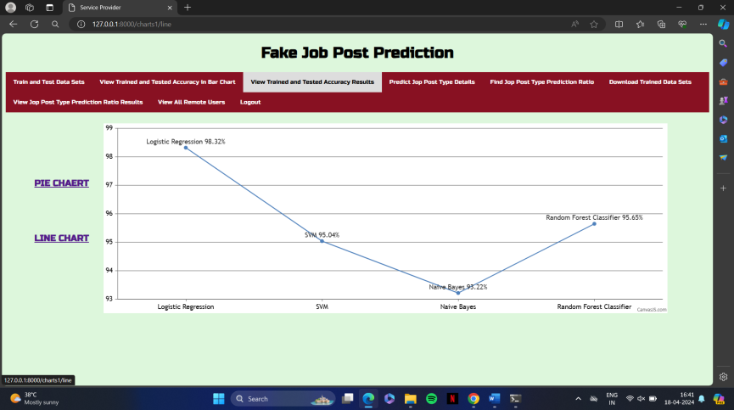
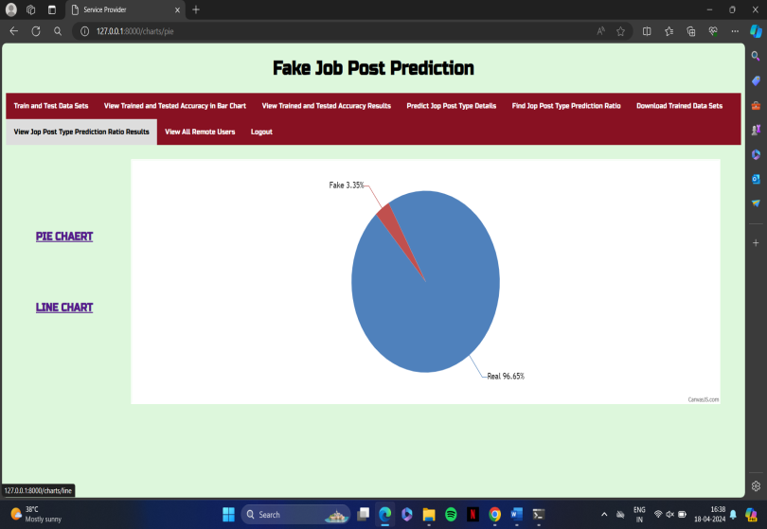
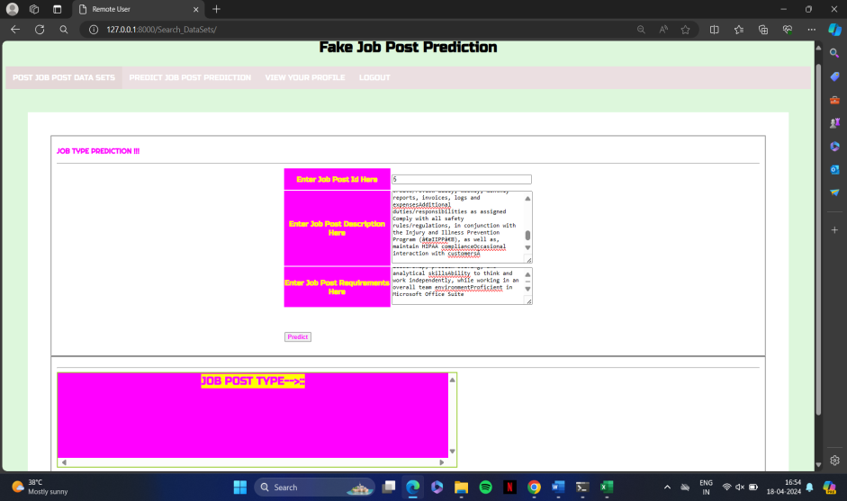
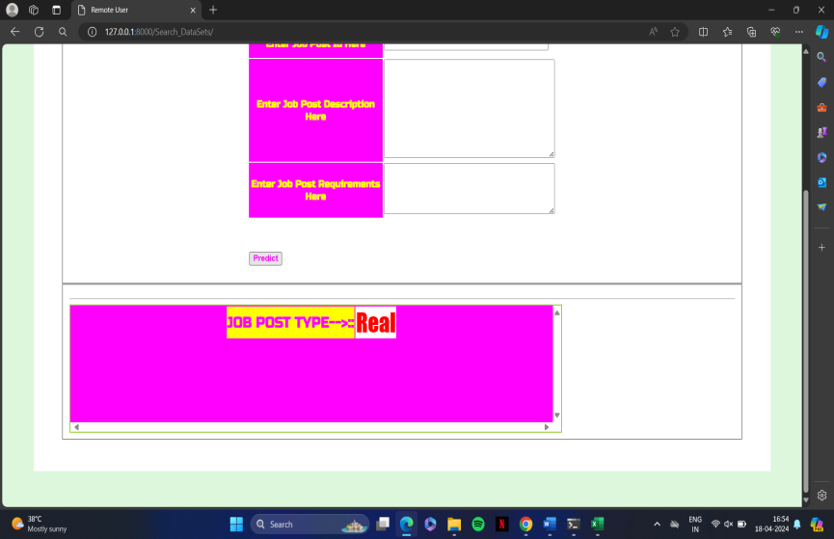
RESULTS

Slide 26
References
[1] S. Vidros, C. Kolias , G. Kambourakis ,and L. Akoglu, “Automatic Detection of Online Recruitment Frauds: Characteristics, Methods, and a Public Dataset”, Future Internet 2017, 9, 6; doi:10.3390/fi9010006.
[2] B. Alghamdi, F. Alharby, “An Intelligent Model for Online Recruitment Fraud Detection”, Journal of Information Security, 2019, Vol 10, pp. 155176
https://doi.org/10.4236/iis.2019.103009 .
[3] Tin Van Huynh1, Kiet Van Nguyen, Ngan Luu-Thuy Nguyen1, and AnhGia-Tuan Nguyen, “Job Prediction: From Deep Neural Network Models to Applications”, RIVF International Conference on Computing and Communication Technologies (RIVF), 2020.
Batch-No 05 Project Title: Securing Employment Opportunities-Machine Learning Solutions for Fake Job Detection

Slide 27
[4] Jiawei Zhang, Bowen Dong, Philip S. Yu, “FAKEDETECTOR: Effective Fake News Detection with Deep Diffusive Neural Network”, IEEE 36th International Conference on Data Engineering (ICDE), 2020.
[5] Scanlon, J.R. and Gerber, M.S., “Automatic Detection of Cyber Recruitment by Violent Extremists”, Security Informatics, 3, 5, 2014,
https://doi.org/10.1186/s13388-014-0005-5
[6] Y. Kim, “Convolutional neural networks for sentence classification,” arXiv Prepr. arXiv1408.5882, 2014.
[7] T. Van Huynh, V. D. Nguyen, K. Van Nguyen, N. L.-T. Nguyen, and A.G.T. Nguyen, “Hate Speech Detection on Vietnamese Social Media Text using the Bi-GRU-LSTM-CNN Model,” arXiv Prepr. arXiv1911.03644, 2019.

Slide 28
CONCLUSION
Job scam detection has become a great concern all over the world at present. In this paper, we have analyzed the impacts of job scam which can be a very prosperous area in research filed creating a lot of challenges to detect fraudulent job posts.We have experimented with EMSCAD dataset which contains real life fake job posts. In this paper we have experimented both machine learning algorithms (SVM, KNN, Naïve Bayes , Random Forest and MLP) and deep learning model (Deep Neural Network).This work shows a comparative study on the evaluation of traditional machine learning and deep learning based classifiers.

